Slide 1
The Adventurous Project of building a processor
A Presentation By TEAM 2: Nate Doher, molly A. lee, & Shea winkler
CSCE 230: Computer organization
university of Nebraska- lincoln
29th November 2017

Slide 2
Objectives
The
Processor that could Implement a
Goal of Our
Project was to Create a
Subset of the NIOS II Architecture and Some
Features Unique to ARM-Like Conditional Executions

Slide 3
outline
Our project was broken up into 6 phases, each of which was vital to the success of the project.
Phase 1: Register File, ALU, & Control Unit
Phase 2: Data Path & R-Type Instructions
Phase 3: Remaining Instructions: R-type, D-type, B-type
Phase 4: I/O & ARM-like Conditional Execution
Phase 5: (Bonus) Additional I/O & J-type Instructions
Phase 6: Design Doc, Presentation, Demo
Phase 7: (Bonus) Assembler

Slide 4
Phase 1: what we tried to accomplish
Create a Register File
Create an ALU
Start Building a Control Unit
Notes:
Control Unit was used for setting flag values that affect the way in which the processor functions. Phase II will implement the control unit to initialize a functioning processor.

Slide 5
Phase 1: what we actually did

Slide 6
Phase 1: difficulties that arose

Slide 7
Phase 2: what we tried to accomplish
Create a Data Path
Create and Compile a Basic Processor
Begin Implementing R-type Instructions:
Addition (Add)
Subtraction (Sub)
Logical And (And)
Logical Or (Or)
Exclusive Or (Xor)
Notes:
In Phase II, Team 2 created the Data Path File for the project and compiled a basic processor for the first time. In this phase, it was only necessary to implement Register-type (R-type) instructions. This was the simplest version of the processor that functions. The successive phases have been built from the working product of this phase.

Slide 8
Phase 2: what we actually did

Slide 9
Phase 2: difficulties that arose

Slide 10
Phase 3: what we tried to accomplish
Implement the Remaining Instructions:
R-type:
Jump Register (JR)
Compare (CMP)
D-type:
Load Word (LW)
Store Word (SW)
Add Immediate (Addi)
B-type:
Branch (Br)
Branch and Link (BAL)
Notes:
In Phase III, Team 2 modified the Data Path and the Control Unit to add new R-type, D-type and B-type instructions, including JR, CMP, LW, SW, ADDI, B and BAL. Team 2 also integrated the memory interface and instruction address generator into the existing processor in this phase. Phase IV will build off Phase III and implement I/O.

Slide 11
Phase 3: what we actually did

Slide 12
Phase 3: difficulties that arose

Slide 13
Phase 4: what we tried to accomplish
Implement Basic I/O:
Pushbuttons
Slider Switch (SW)
Green LEDs (LEDG)
ARM-like Conditional Execution:
Branch on Equals (BEQ)
Notes:
The main purpose of Phase IV was to add basic I/O and ARM-like execution [2].

Slide 14
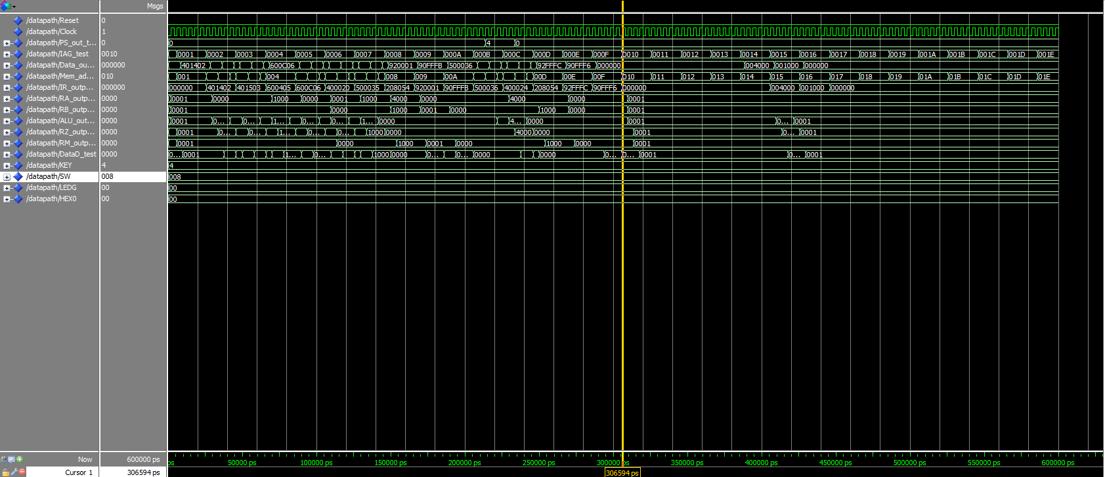
Phase 4: what we Submitted (20 Nov. 2017)
No Branch!
No
Branch-and-Link!
Bitmap Submitted

Slide 15
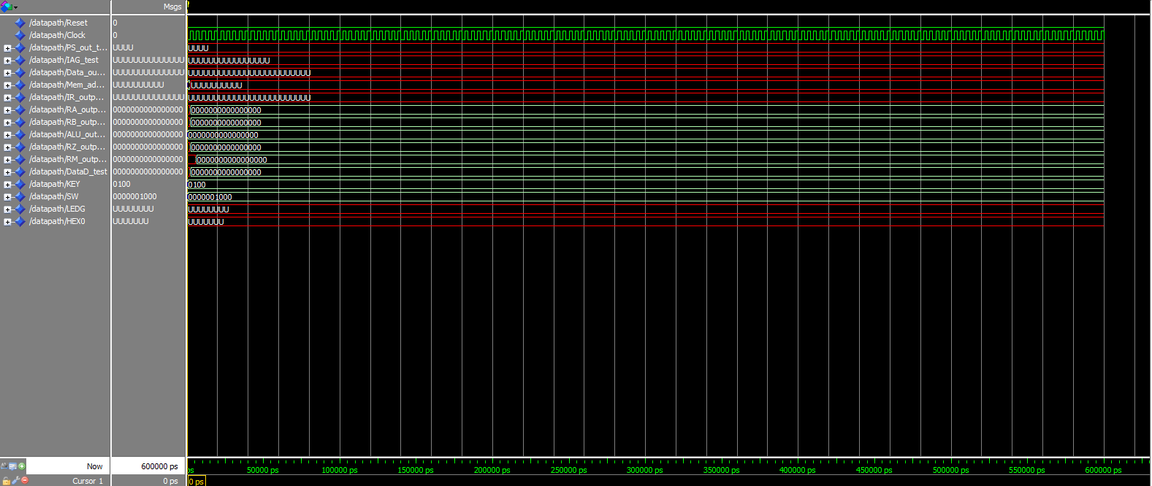
Phase 4: difficulties that arose

Slide 16
Phase 5: what we tried to accomplish
Extending I/O
Hex1, Hex2, Hex3
Red LEDs (LEDR)
Adding J-type instructions:
Jump (J)
Jump and Link (JAL)
Load Immediate (LI)

Slide 17
Phase 5: what we actually did

Slide 18
Phase 5: difficulties that arose

Slide 19
Phase 6: what we tried to accomplish
Written Report: Team 2 Design Doc
Team 2 Presentation
Team 2 Demo

Slide 20
Phase 6: what we actually did

Slide 21
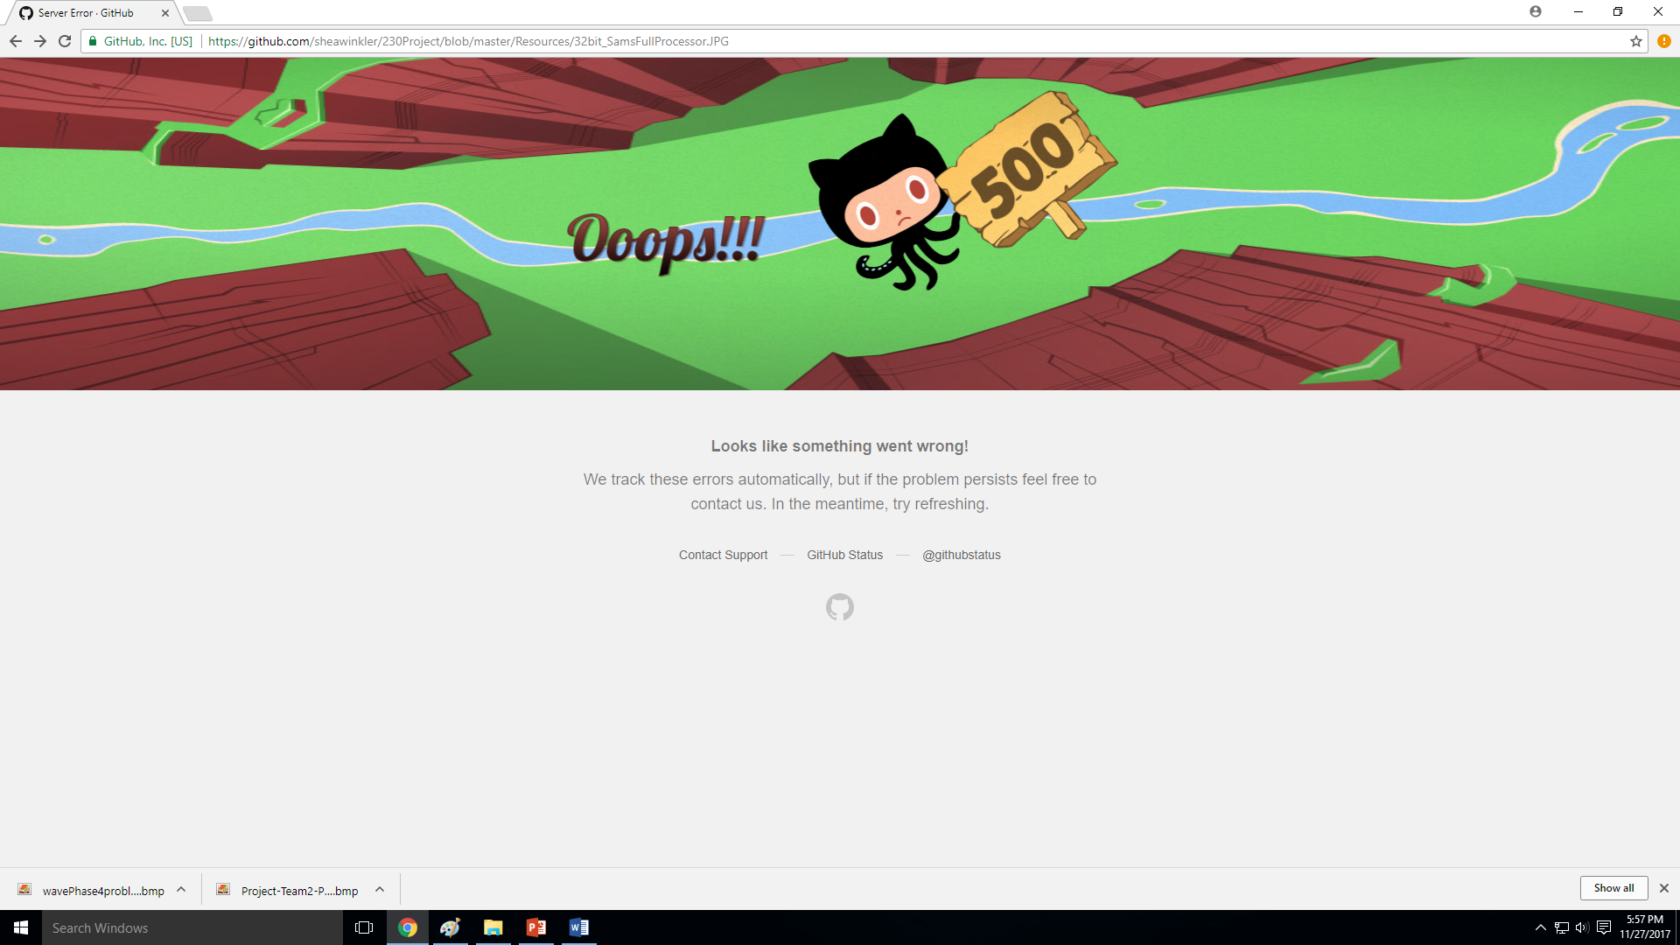
Phase 6: difficulties that arose

Slide 22
Final result

Slide 23
summary

Slide 24
SUMMARY
The goal of our project was to create a processor that could implement a subset of the NIOS II Architecture and some features unique to ARM.
In Phase 1, we created the Register File, ALU, & Control Unit.
In Phase 2, we implemented the Data Path & R-Type Instructions.
In Phase 3, we implemented the remaining R-type, D-type, B-type instructions.
In Phase 4, we implemented I/O & ARM-like Conditional Execution.
In Phase 5, we had the option to do more I/O & J-type Instructions.
In Phase 6, we created the Final Design Doc, Presentation, & Demo.
In Phase 7, we created an Assembler for Bonus Points.

Slide 25
conclusion

Slide 26
References

Slide 27
We would like to thank:
Aaron Johnson
Quinn Lanik
Jianfei Shao
Matt Bennett
Samuel Hansen
Tyler Bienhoff
Dr. Witty Srisa-an
Dr. Riedesel
Michael Fay

Slide 28
Questions?

